Slide 1
JDBC

Slide 2
Java Database Connectivity

Slide 3
Lecture Objective
JDBC Fundamentals
Steps to create Application
JDBC Driver Types
JDBC Connections
JDBC Statements
Complete Implementation of Application

Slide 4
Introduction to JDBC

Slide 5
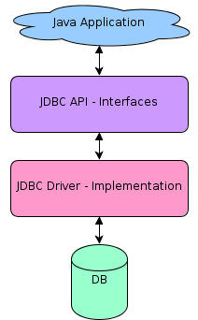


What is JDBC
“It is a standard Java API for database-independent connectivity between the java programming language and a wide range of databases”

Slide 6
What is JDBC
JDBC or Java Database Connectivity is a Java API to connect and execute the query with the database. It is a specification from Sun microsystems that provides a standard abstraction(API or Protocol) for java applications to communicate with various databases. It provides the language with java database connectivity standards. It is used to write programs required to access databases. JDBC, along with the database driver, can access databases and spreadsheets. The data stored in a relational database(RDB) can be accessed with the help of JDBC APIs.

Slide 7
What is JDBC
Connection
Create SQL Database
3
1
2
Execute SQL\Quries
4
Viewing\Ouput

Slide 8
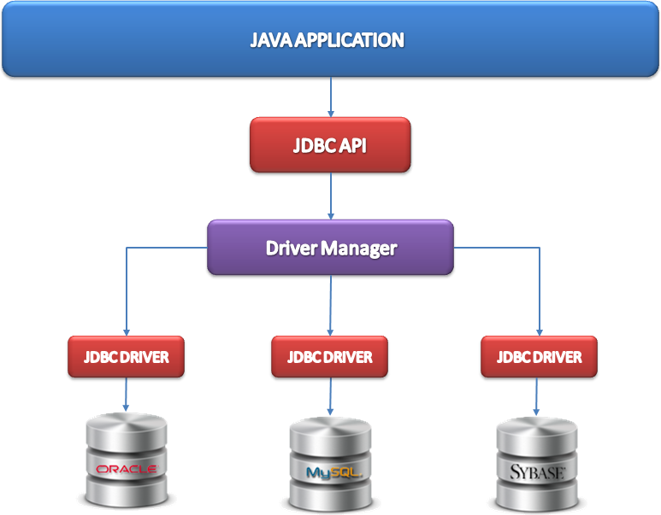
JDBC Architecture

Slide 9
JDBC Architecture
JDBC Architecture consists of two layers −
JDBC API: This provides the application-to-JDBC Manager connection.
JDBC Driver API: This supports the JDBC Manager-to-Driver Connection.

Slide 10
Common JDBC Components
DriverManager is used to manage a list of database drivers.
Driver is an interface that handles the communications with the database server.
Connection is an interface that consists all the methods required to connect to a database.

Slide 11
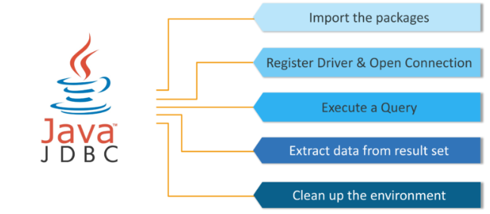
Steps to create JDBC Application

Slide 12
JDBC Driver Type
JDBC drivers implement the defined interfaces in the JDBC API, for interacting with your database server. Essentially, a JDBC driver makes it possible to do three things: 1. Establish a connection with a data source. 2. Send queries and update statements to the data source. 3. Process the results.
There are 4 types of drivers.

Slide 13
JDBC Connections
Import JDBC Packages
Register JDBC Driver
Database URL Formulation
Create a connection object
Close

Slide 14
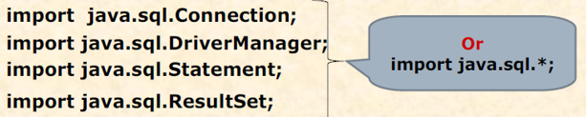
Import JDBC Packages
Add import statements to Java program to import required classes in your Java code.

Slide 15
Register JDBC Driver
This step causes the JVM to load the desired driver implementation into memory so that it can fulfill your JDBC requests.
The most common approach to register a driver is to use Java’s forName()method to dynamically load the driver’s class file into memory, which automatically registers it. This method is preferable because it allows to make the driver registration configurable and portable.
Refer the below code.
1 2 3 4 5 6 7 | try { Class.forName(“com.mysql.jdbc.Driver"); } catch(ClassNotFoundException ex) { System.out.println("Error: unable to load driver class!"); System.exit(1); }

Slide 16
Opening a connection
This is to create a properly formatted address that points to the database to which need to connect.
DriverManager.getConnection() requires the complete address of the database
Database URL
UserName
Password

Slide 17
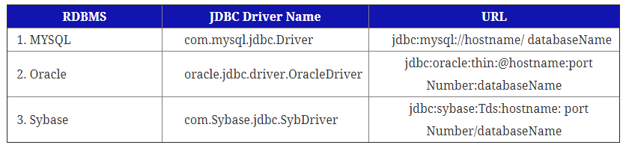
A table lists down the popular JDBC driver names and database URL.

Slide 18

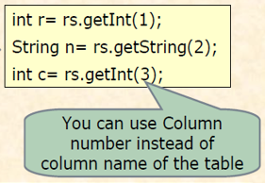
Executing a query

Slide 19
Close
At the end of your JDBC program, we have to close all the database connections to end each database session. However, if you forget, Java’s garbage collector will close the connection when it cleans up stale objects.
1 | conn.close();

Slide 20


